Slide 1
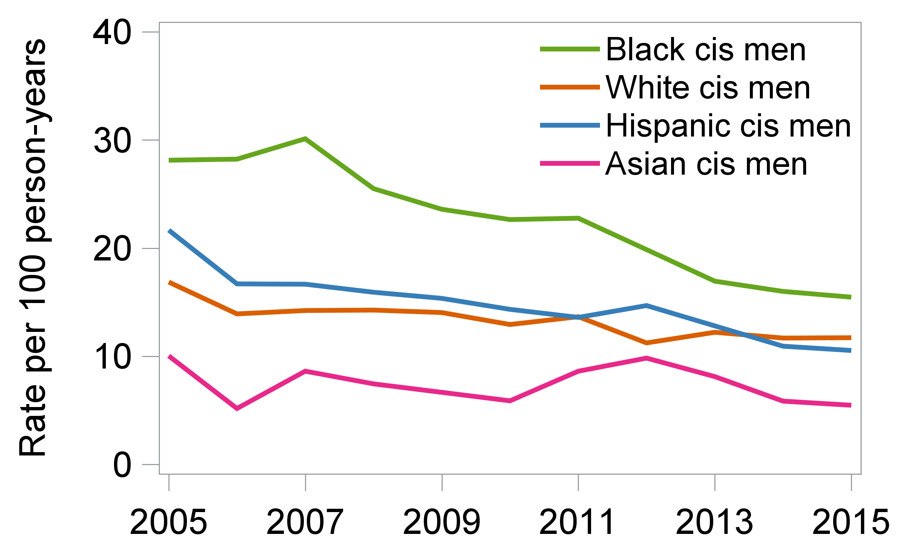
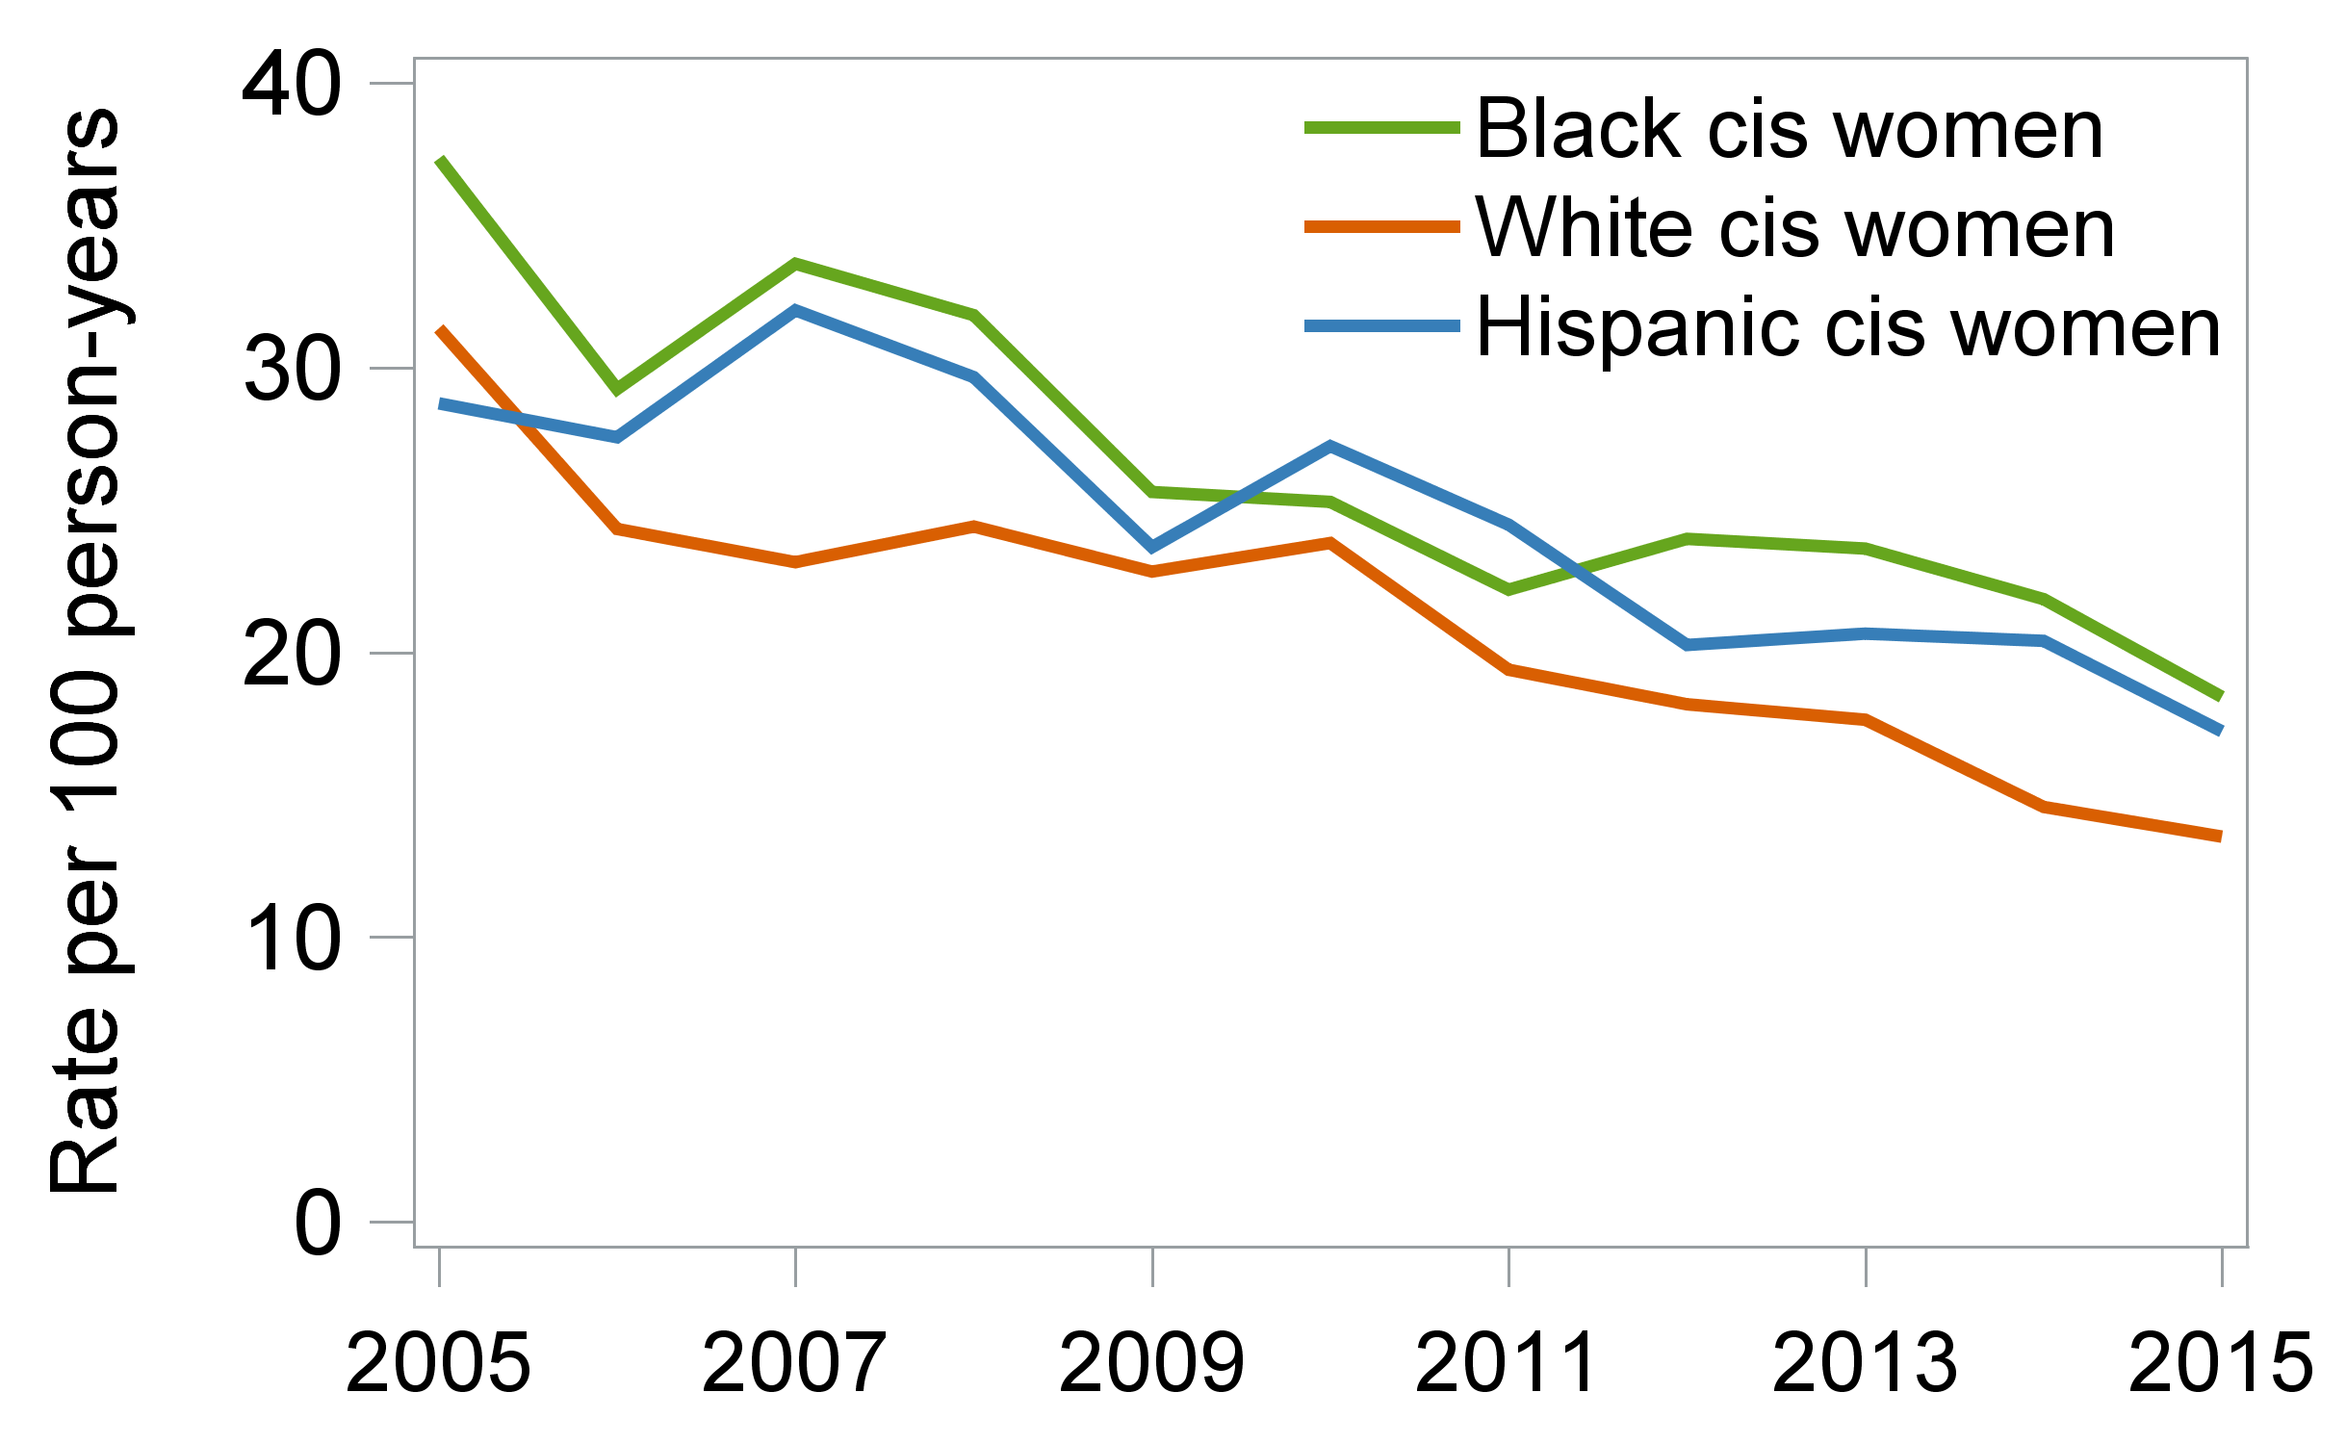
Racial, ethnic, and gender disparities in hospitalizations among persons with HIV in the US and Canada, 2005–2015 T. Davy-Mendez,¹ S. Napravnik,¹ J. J. Eron,¹ S. R. Cole,¹ D. van Duin,¹ D. A. Wohl,¹ B. Hogan,² J. Fleming,³ M. A. Horberg,⁴ J. N. Martin,⁵ N. G. A. Nanditha,⁶ P. F. Rebeiro,⁷ M. J. Silverberg,⁸ K. A. Gebo,² S. A. Berry,² for the NA-ACCORD of IeDEA ¹ UNC Chapel Hill, ² Johns Hopkins University, ³ Fenway Health, ⁴ Kaiser Permanente Mid-Atlantic Permanente Research Institute, ⁵ UC San Francisco, ⁶ University of British Columbia, ⁷ Vanderbilt University, ⁸ Kaiser Permanente Northern California
Contact
Thibaut Davy-Mendez
tdavy@med.unc.edu
Abstract #
PEB0218
@NAACCORD @IeDEAGlobal
Introduction
Results (continued)
Hospitalization rates among persons with HIV (PWH) have decreased in recent years.
Racial, ethnic, and gender disparities in HIV treatment outcomes, comorbidities, and risk factors might contribute to differences in hospitalization rates.
We examined all-cause and cause-specific hospitalization rates by race, ethnicity, and gender among persons in HIV care in the US and Canada.
Table 1. Characteristics of patients in care in six clinical cohorts between 2005 and 2015, stratified by race and ethnicity.
Table 2. Distribution of outcomes and person-years, annual percentage change in rates, and IRR for all-cause hospitalizations.
Characteristic | White N=11,526 | Black N=8947 | Hispanic, any race N=4611 | Asian N=1052 | Indigenous N=320 | Multiracial or other N=629
Gender
Cisgender men | 10,507 (91%) | 5803 (65%) | 3786 (82%) | 925 (88%) | 225 (70%) | 515 (82%)
Cisgender women | 975 (8%) | 3095 (35%) | 782 (17%) | 115 (11%) | 91 (28%) | 109 (17%)
Transgender | 44 (<1%) | 49 (<1%) | 43 (1%) | 12 (1%) | 4 (1%) | 5 (<1%)
HIV risk group
MSM | 7942 (69%) | 2556 (29%) | 2530 (55%) | 722 (69%) | 90 (28%) | 362 (58%)
IDU | 1506 (13%) | 1450 (16%) | 449 (10%) | 52 (5%) | 114 (36%) | 45 (7%)
Hetero./other | 2078 (18%) | 4941 (55%) | 1632 (35%) | 278 (26%) | 116 (36%) | 222 (35%)
Enrolled in a US cohort | 10,119 (88%) | 8395 (94%) | 4543 (99%) | 925 (88%) | 91 (28%) | 602 (96%)
Age at study start, median years (IQR) | 42 (35, 50) | 41 (32, 48) | 39 (32, 47) | 37 (31, 44) | 36 (30, 43) | 38 (30, 46)
CD4 at cohort entry, median cells/µL (IQR) | 425 (233, 628) | 350 (158, 548) | 372 (184, 573) | 372 (210, 550) | 307 (177, 510) | 396 (231, 607)
Gender, race, and ethnicity | # of hosps./ person-years | Annual Percentage Change (95% CI) |  | IRR (95% CI)
 |  | Unadjusted | Adjusted | Unadjusted | Adjusted
Cisgender men
White | 6639 / 50,520 | -3 (-4, -2) | -1 (-2, 1) | 1 (ref.) | 1 (ref.)
Black | 5252 / 24,052 | -6 (-7, -4) | -2 (-4, 0) | 1.46 (1.32, 1.61) | 1.27 (1.14, 1.41)
Hispanic | 2320 / 16,320 | -5 (-7, -3) | -2 (-4, 1) | 1.01 (0.90, 1.13) | 0.98 (0.87, 1.10)
Asian | 298 / 4096 | -2 (-8, 4) | 0 (-6, 7) | 0.62 (0.50, 0.75) | 0.64 (0.53, 0.78)
Indigenous | 246 / 997 | 1 (-7, 9) | 4 (-5, 14) | 1.99 (1.44, 2.74) | 1.62 (1.18, 2.22)
Multiracial/other | 182 / 1522 | 4 (-3, 11) | 6 (-1, 14) | 0.82 (0.53, 1.28) | 0.88 (0.57, 1.38)
Cisgender women
White | 994 / 4791 | -7 (-10, -3) | -2 (-6, 2) | 1 (ref.) | 1 (ref.)
Black | 3743 / 14,494 | -5 (-7, -3) | -2 (-5, 0) | 1.13 (0.94, 1.35) | 1.15 (0.97, 1.37)
Hispanic | 930 / 3819 | -5 (-8, -1) | -2 (-6, 2) | 1.10 (0.88, 1.38) | 1.11 (0.89, 1.38)
Asian* | 74 / 607 |  |  | 0.68 (0.43, 1.08) | 0.74 (0.47, 1.15)
Indigenous* | 152 / 362 |  |  | 2.55 (1.68, 3.89) | 1.88 (1.31, 2.68)
Multiracial/other* | 62 / 405 |  |  | 0.70 (0.35, 1.39) | 0.80 (0.41, 1.56)
Methods
Study population
Patients aged ≥18 years old in HIV care in 5 US and 1 Canadian clinical cohorts between 2005 and 2015
Being in care was defined as ≥1 CD4 count or HIV viral load (VL) every 12 months. Patients returning to care could re-enter analyses.
Study outcomes
All-cause and cause-specific hospitalizations
ICD-9 codes for primary discharge diagnoses were categorized using modified Clinical Classifications Software
Analysis stratified by gender
Use Poisson regression models with GEE to estimate incidence rate ratios for
Calendar time trends in rates by race and ethnicity
Comparisons of racial and ethnic groups
In adjusted analyses, models included NA-ACCORD cohort, IDU history, and annually-updated age, CD4 count, and VL.
*Annual percentage change not estimated due to small sample size.
Figure 1. Unadjusted all-cause hospitalization rates stratified by race and ethnicity among cisgender men (A) and women (B).
Table 3. Adjusted IRR for the 5 most frequent categories of hospital discharge diagnosis (% of hospitalizations).
A
Gender, race, and ethnicity | Non-AIDS-defining infection (25%) | Cardiovascular (10%) | Liver/gastro-intestinal (9%) | Psychiatric (8%) | AIDS-defining illness (7%)
Cisgender men (vs. White)
Black | 1.14 (0.99, 1.30) | 1.61 (1.23, 2.10) | 1.04 (0.80, 1.34) | 1.17 (0.86, 1.58) | 1.17 (0.87, 1.59)
Hispanic | 0.92 (0.79, 1.08) | 1.07 (0.81, 1.40) | 1.19 (0.94, 1.51) | 0.75 (0.53, 1.05) | 1.29 (0.98, 1.70)
Asian | 0.67 (0.50, 0.88) | 0.58 (0.35, 0.94) | 0.47 (0.28, 0.78) | 0.74 (0.43, 1.29) | 1.01 (0.42, 2.42)
Indigenous | 2.12 (1.46, 3.10) | 1.46 (0.51, 4.19) | 1.98 (1.05, 3.76) | 0.93 (0.40, 2.15) | 1.43 (0.80, 2.57)
Multiracial/other | 0.92 (0.56, 1.50) | 1.40 (0.49, 4.01) | 1.25 (0.68, 2.33) | 0.83 (0.37, 1.87) | 0.86 (0.35, 2.11)
Cisgender women (vs. White)
Black | 1.07 (0.83, 1.37) | 1.92 (1.13, 3.25) | 1.09 (0.73, 1.62) | 0.64 (0.43, 0.95) | 0.86 (0.58, 1.27)
Hispanic | 1.01 (0.74, 1.39) | 1.51 (0.92, 2.48) | 1.52 (0.96, 2.41) | 0.86 (0.31, 2.35) | 0.89 (0.53, 1.51)
Conclusions
B
Among people in HIV care, from 2005 to 2015, unadjusted all-cause hospitalization rates:
Decreased for almost all racial, ethnic, and gender groups
Were generally highest for Black cisgender women
After adjusting for changes in VL and CD4 count, all-cause hospitalization rates were stable over time in all groups.
Rates were higher for Black, Hispanic, and Indigenous vs. White patients for all-cause and several cause-specific hospitalizations.
Disparities persisted in analyses adjusted for VL and CD4 count. Other possible contributors to hospitalization disparities include clinical factors such as differences in comorbidities, and structural factors such as stigma and limited access to non-HIV care.
Results
27,085 patients contributed 122,566 person-years of follow-up.
27% of patients were hospitalized at least once, for a total 21,036 hospitalizations.
From 2005 to 2015, the current median age increased from 43 to 49 years, CD4 count from 384 to 573 cells/µL, and proportion of patients with VL<400 copies/mL from 52% to 83%.
Acknowledgements
The content is solely the responsibility of the authors and does not necessarily represent the official views of the National Institutes of Health. This work was supported by National Institutes of Health grants U01AI069918, F31AI124794, F31DA037788, G12MD007583, K01AI093197, K01AI131895, K23EY013707, K24AI065298, K24AI118591, K24DA000432, KL2TR000421, N01CP01004, N02CP055504, N02CP91027, P30AI027757, P30AI027763, P30AI027767, P30AI036219, P30AI050409, P30AI050410, P30AI094189, P30AI110527, P30MH62246, R01AA016893, R01DA011602, R01DA012568, R01 AG053100, R24AI067039, U01AA013566, U01AA020790, U01AI038855, U01AI038858, U01AI068634, U01AI068636, U01AI069432, U01AI069434, U01DA03629, U01DA036935, U10EY008057, U10EY008052, U10EY008067, U01HL146192, U01HL146193, U01HL146194, U01HL146201, U01HL146202, U01HL146203, U01HL146204, U01HL146205, U01HL146208, U01HL146240, U01HL146241, U01HL146242, U01HL146245, U01HL146333, U24AA020794,U54MD007587, UL1RR024131, UL1TR000004, UL1TR000083, Z01CP010214 and Z01CP010176; contracts CDC-200-2006-18797 and CDC-200-2015-63931 from the Centers for Disease Control and Prevention, USA; contract 90047713 from the Agency for Healthcare Research and Quality, USA; contract 90051652 from the Health Resources and Services Administration, USA; grants CBR-86906, CBR-94036, HCP-97105 and TGF-96118 from the Canadian Institutes of Health Research, Canada; Ontario Ministry of Health and Long Term Care; and the Government of Alberta, Canada. Additional support was provided by the National Institute Of Allergy And Infectious Diseases (NIAID), National Cancer Institute (NCI), National Heart, Lung, and Blood Institute (NHLBI), Eunice Kennedy Shriver National Institute Of Child Health & Human Development (NICHD), National Human Genome Research Institute (NHGRI), National Institute for Mental Health (NIMH) and National Institute on Drug Abuse (NIDA), National Institute On Aging (NIA), National Institute Of Dental & Craniofacial Research (NIDCR), National Institute Of Neurological Disorders And Stroke (NINDS), National Institute Of Nursing Research (NINR), National Institute on Alcohol Abuse and Alcoholism (NIAAA), National Institute on Deafness and Other Communication Disorders (NIDCD), and National Institute of Diabetes and Digestive and Kidney Diseases (NIDDK).
Annual rates were not estimated for some groups due to small sample size.

